Slide 1


Enlive - AI powered tool to create ads for SMEs

Slide 2

The problem:
Small and medium enterprises (SMEs) often face a significant challenge in allocating sufficient funds for advertising creation. Limited budgets restrict their ability to develop impactful ad campaigns, hindering their visibility and growth potential in competitive markets. This financial constraint leads to a disparity in marketing resources compared to larger competitors, impacting SMEs' ability to reach and engage with their target audiences effectively.

Slide 3

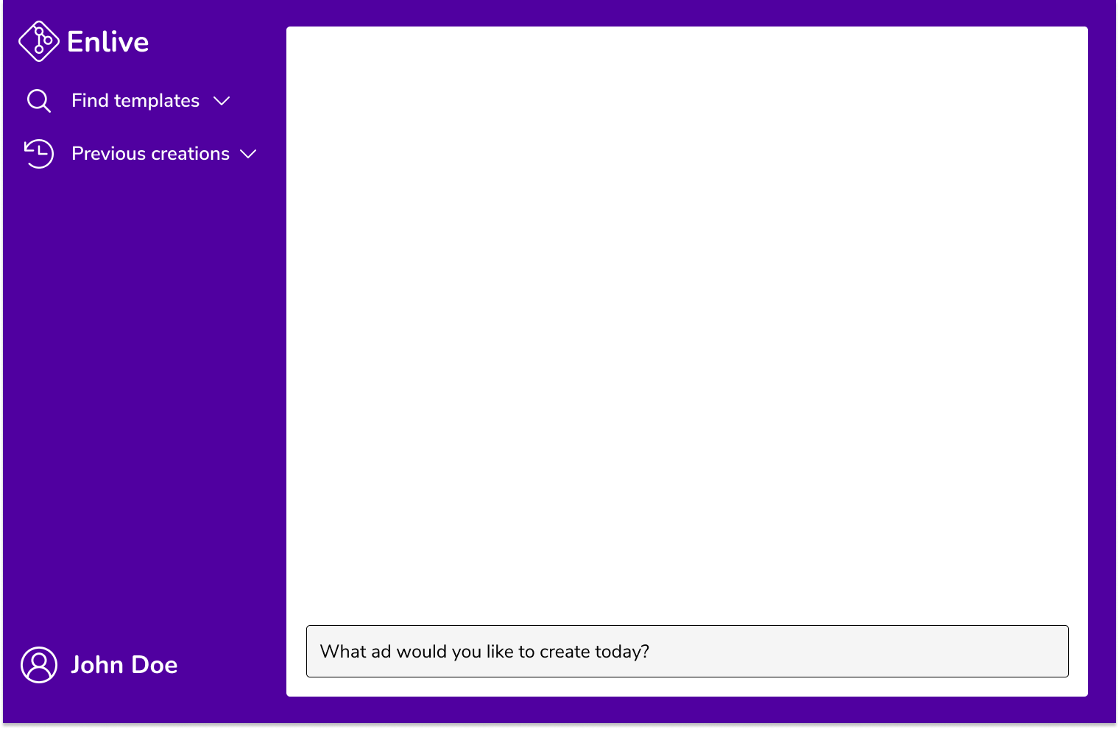
The solution:
Enlive is an AI-powered tool designed to empower small and medium enterprises (SMEs) in creating impactful advertisements without the need for extensive resources or expertise. By leveraging AI technologies to streamline the ad creation process, allowing SMEs to create professional-quality ads quickly and cost-effectively. With our tool, SMEs can now compete with larger competitors on a level playing field, maximizing their marketing impact and driving business growth. Our tool simplifies the ad creation process by allowing users to input simple prompts and receive high-quality images tailored for their campaigns. With a wide range of customizable templates, SMEs can effortlessly create ads that resonate with their target audience, all within a few clicks.

Slide 4




Technologies used

Slide 5
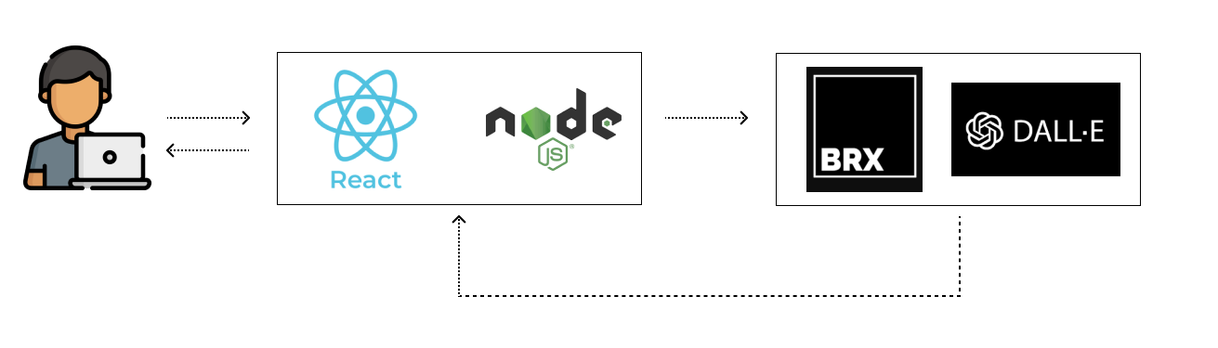
How it works (Architecture)
Once a user enters a prompt, React gives the prompt entered to BRX via Node JS. BRX interacts with Dall-E to create the image and returns it to React. The image is then displayed to the user.

Slide 6
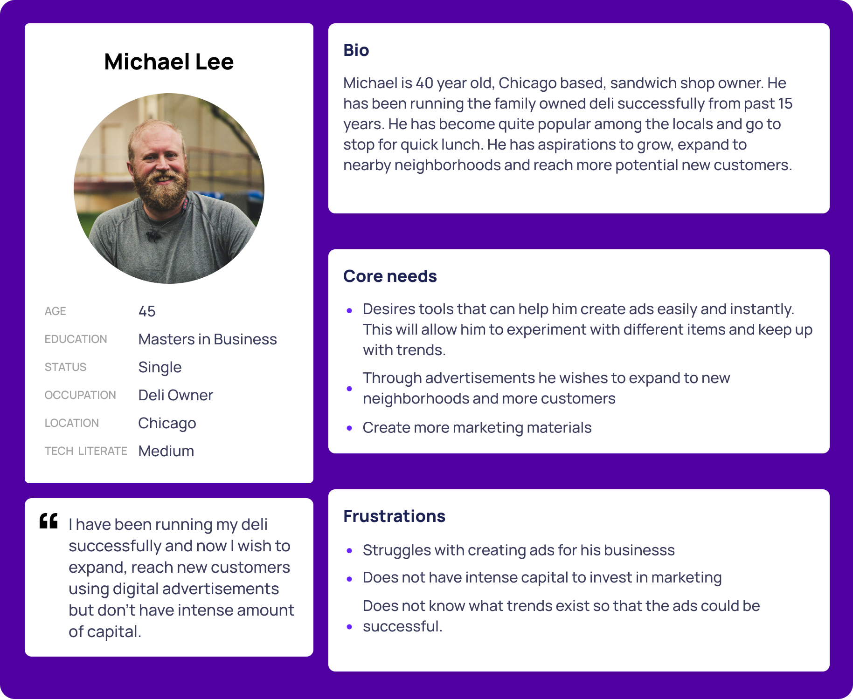
Persona
By using Enlive, Michael will be able to create ads easily and instantly. This will allow him to create multiple ads and experiment what works best with his audience. As Enlive is an open source platform he will be able to this at no cost. By using templates he will be able to customise ads as per needs.

Slide 7

Use cases
Create Ads
Customise Ads
SMEs can use it to create ads instantly with limited input.
SMEs can create customised ads using the templates.
Analytics
Sharing
SMEs will be see the performance of their ads and can keep track of the ads that were successful.
Social media accounts of SMEs can be integrated so that they can share it on multiple platforms in one go.

Slide 8
Market opportunity
According to Borrell Associates:
Small and medium-sized businesses (SMBs) in the US spend an average of $1,200 per month on advertising, for a total of $101.5 billion in local advertising.
61% of SMB advertisers spend more than $10,000 annually on advertising.
29% spend more than $100,000 annually.
62% of SMBs dedicate 4% or more of their revenue to marketing.
2% of SMBs believe that digital ads target customers more efficiently.
12% of all searches are now for local products and services.

Slide 9
Challenges we faced
Initially our idea was to create an AI powered tool to create video ads. During research, we found multiple softwares like Google Creative Labs, Haygen and others will have to be integrated for execution. We did not have enough time and some softwares we paid due to this we decide to create poster ads instead.
While creating poster ads, it was difficult to create the system that allows the users to customise ads section because it required replacement of original image with the image user wants. This process requires image masking using AI and we could not find softwares that allow to do this seamlessly. More research is needed in this area.
The product requires immense amount of data input in AI and images for it to accommodate various industries and produce results for any prompt. This will require more time and data models.

Slide 10
Future Work
The ability for AI to create video ads
Improvise the current poster ads generated
Create more customisation options
Ability to directly post ads on multiple platforms
Integrate analytics to view performance of the ads created

Slide 11
Team
Sreeved Krishna PS
Bhavna Idnani
Dhanalakshmi Sangaraju
Dhanalakshmi Nallaka
Harigovind R

